Slide 1
Auto Clave Tests

Slide 2
Background
For the longitudinal TEER test, we want a sterile environment for transwells to be in and the easiest way to achieve this is via autoclaving.
Fused Filament 3D printing is impossible to achieve this with. I tried several polymers and the geometry distortion is tremendous.
UV curable resin might be better though

Slide 3
Siraya Tech Blu clear V2 resin
This is a cheap, common clear resin for SLA printing.
property | before | After
Lower OD | 23.81 | 23.93
Lower ID | 15.83 | 15.72
Upper OD | 29.91 | 29.9
Upper ID | 24.18 | 24.15
Large tab width | 4.95 | 5.00
Small tab width | 3.01 | 3.02
Large tab socket width | 5.31 | 5.37
Small tab socket width | 3.32 | 3.45

Slide 4
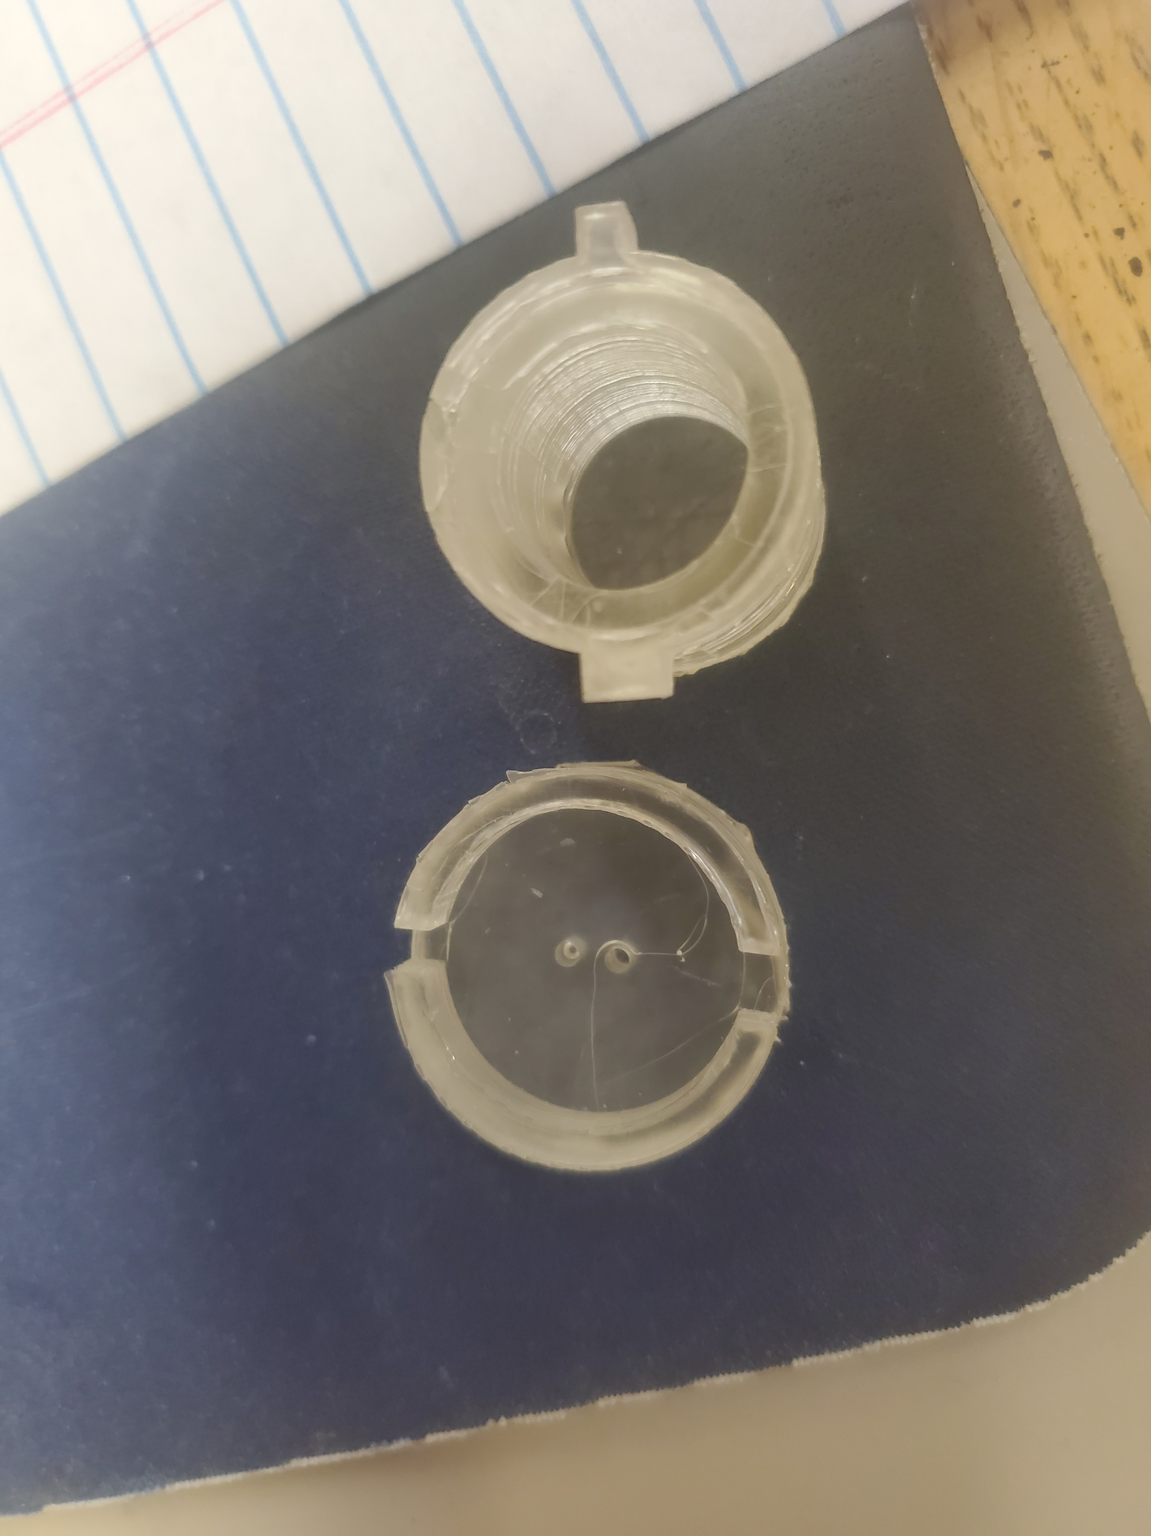
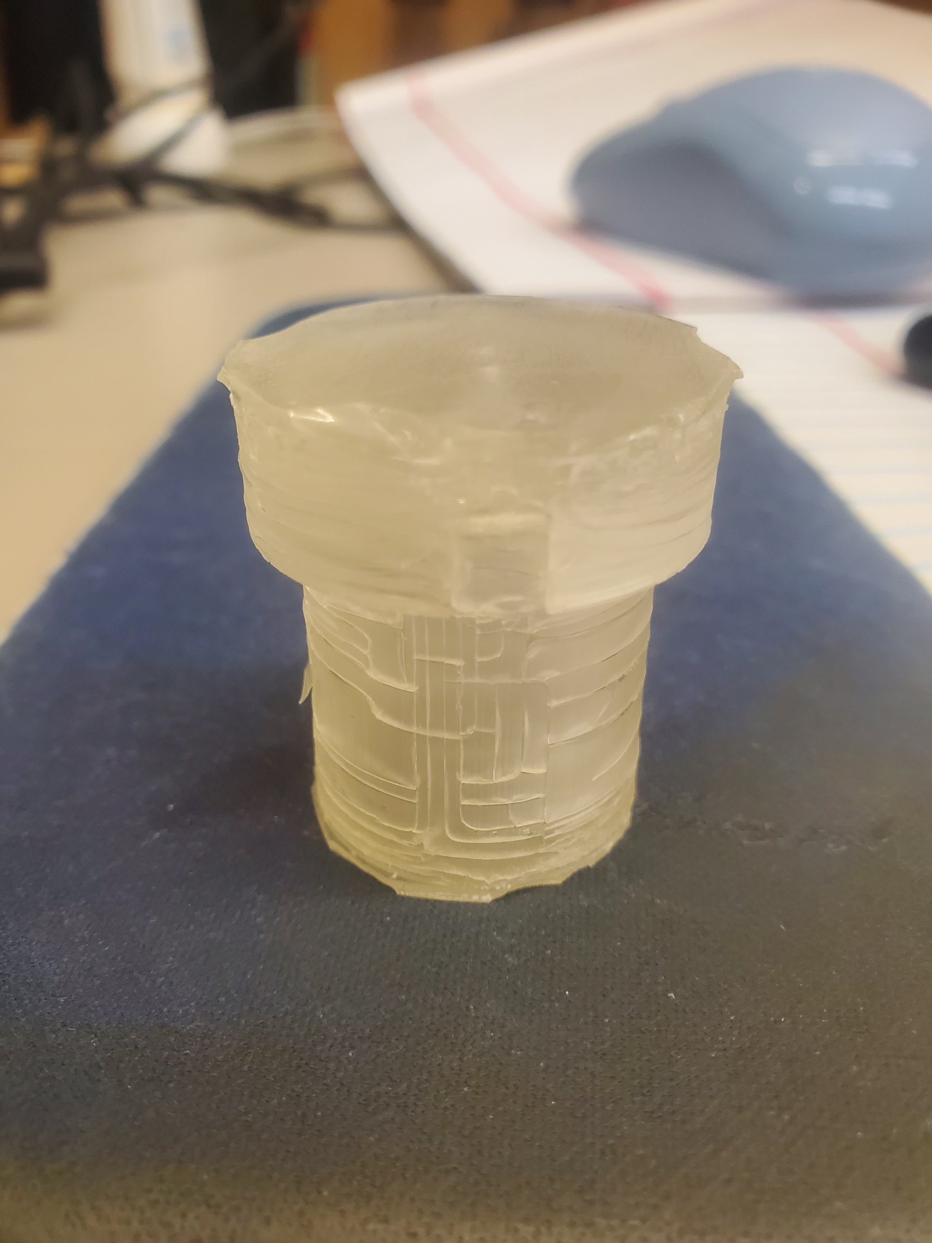
After Pics and Conclusion
Minimal physical distortion
Very clear physical stress damage to material
Material was very rigid before autoclave, after was semi-pliable. I could noticeably distort chape by squeezing with hand.
Verdict = Not Suitable

Slide 5
Liqcreate Bio-Med Clear
Formulated to with stand autoclaving with staying rigid and not cracking and not dimensionally warping.
property | before | After
Lower OD | 23.94 | 23.93
Lower ID | 15.99 | 16.06
Height | 27.56 | 27.67
Electrode dia | 1.93/1.80 | 2.03/1.94

Slide 6
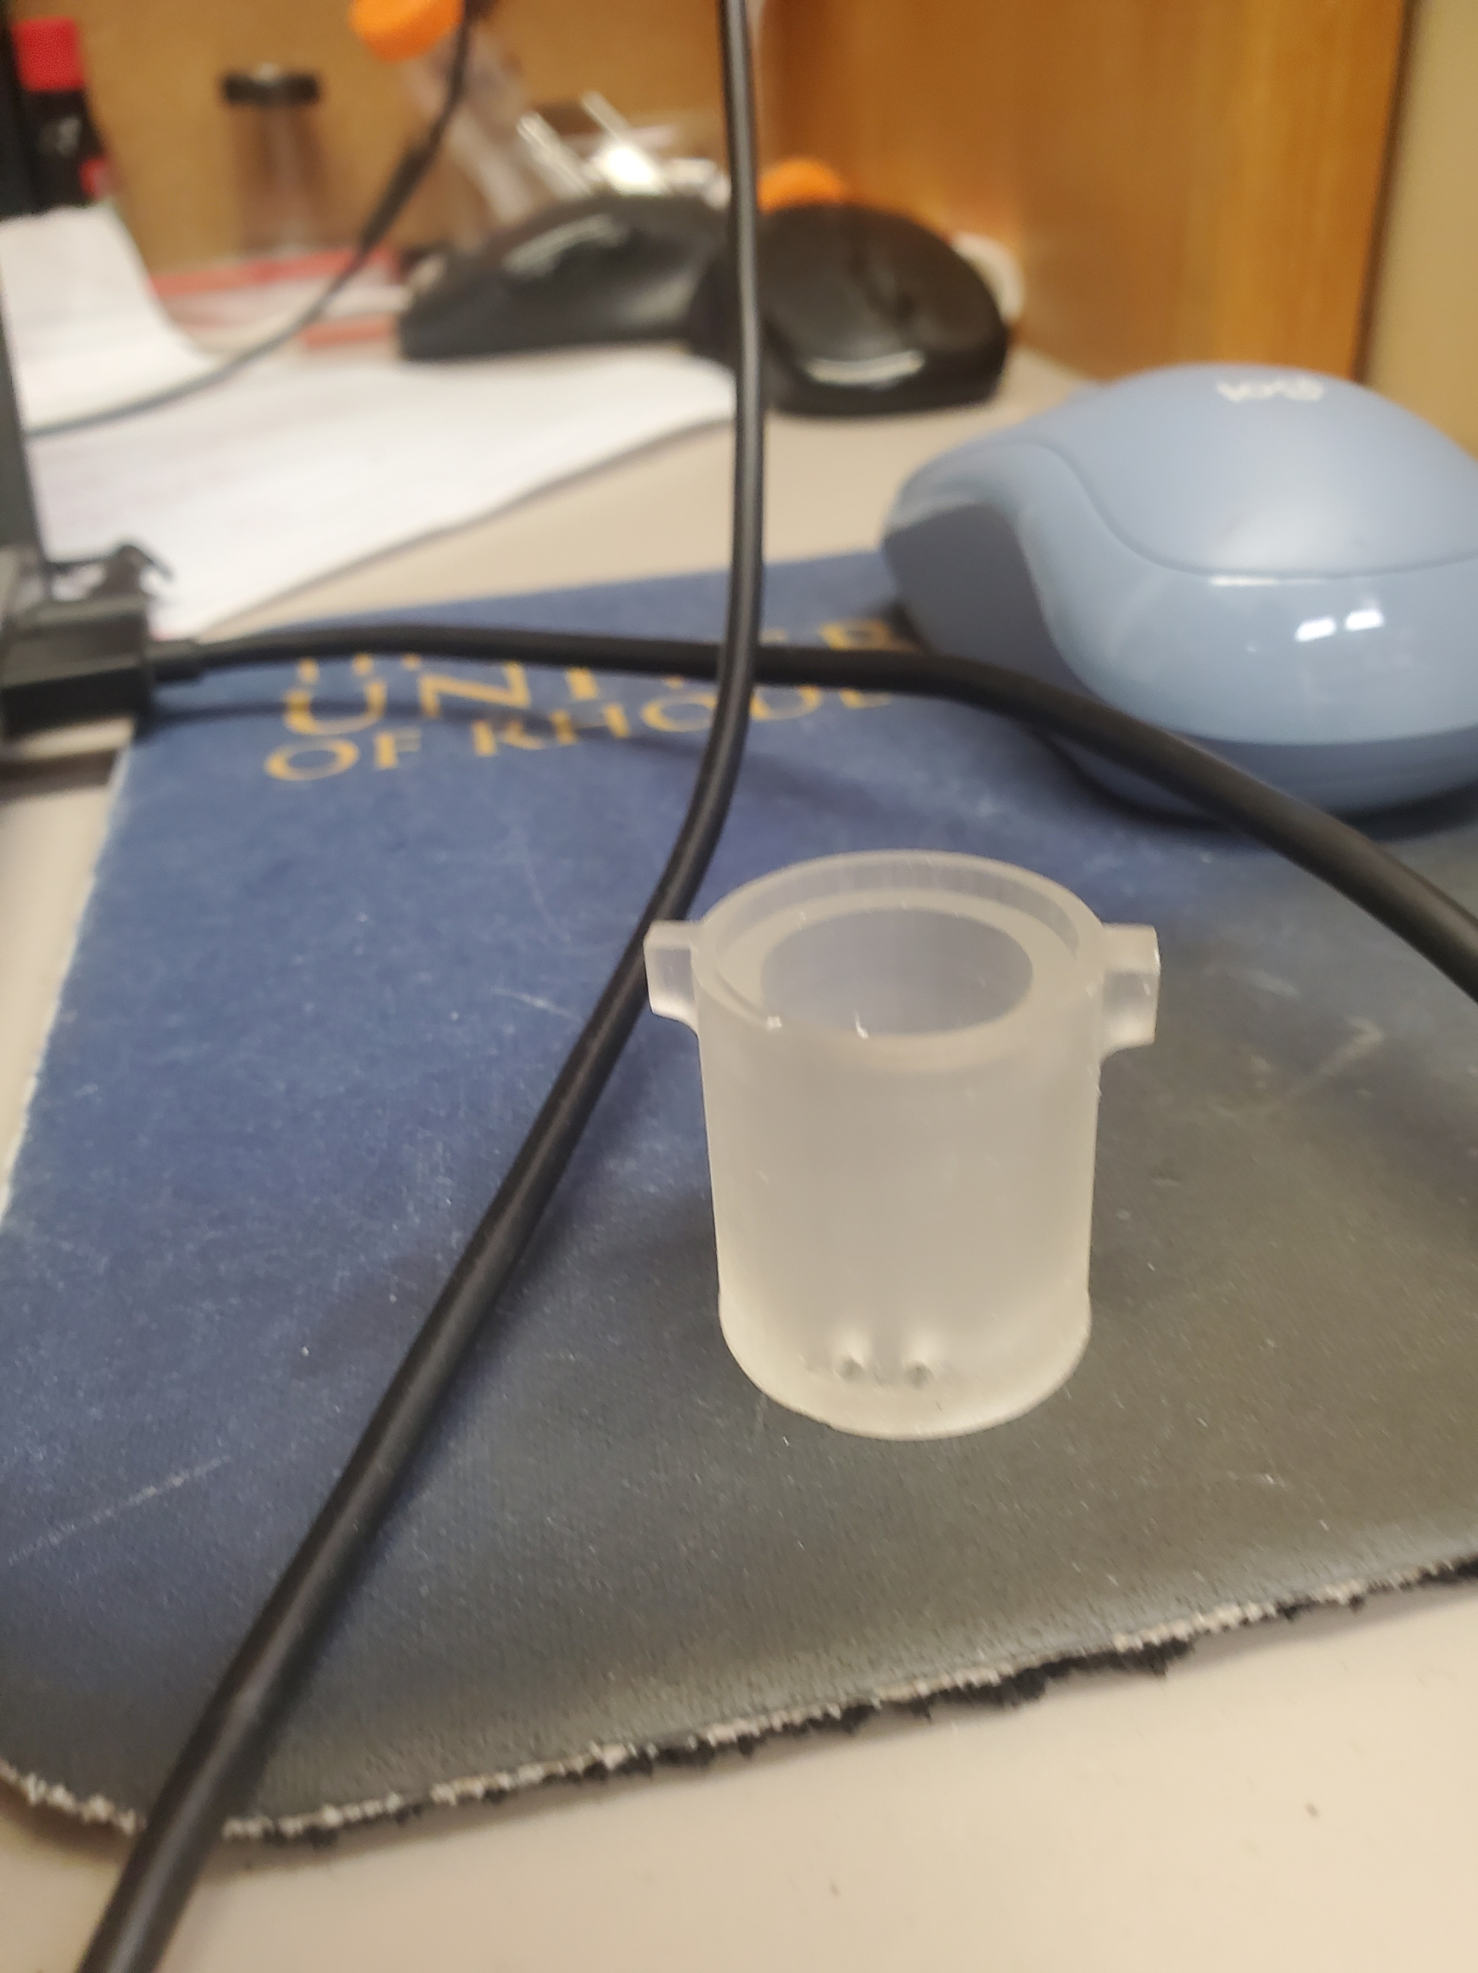
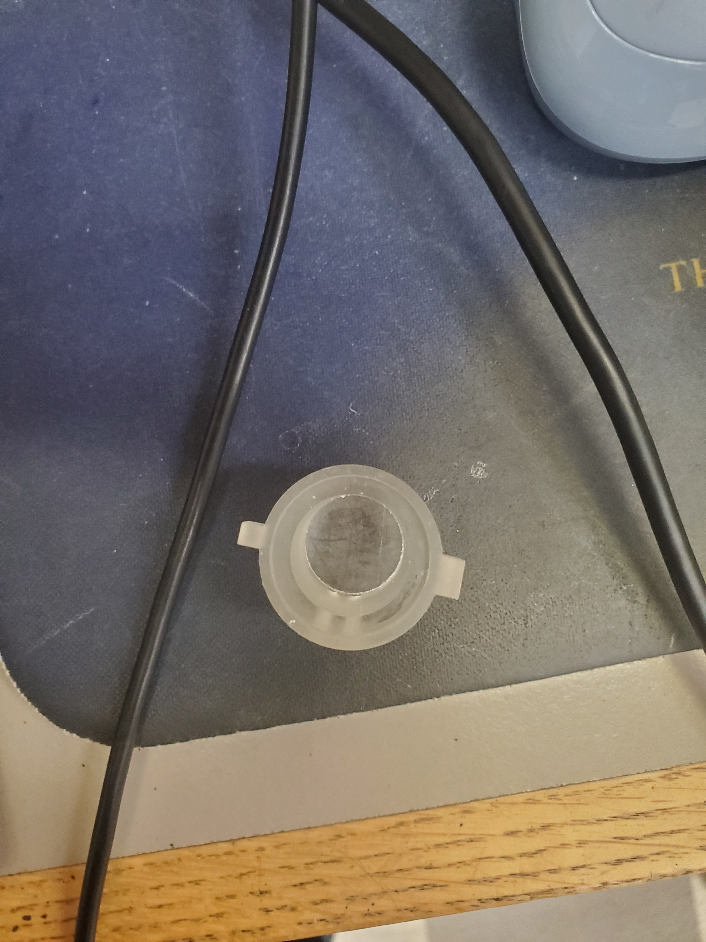
After pics
Virtually no damage done
Virtually no dimensional changes
This is the resin to use.

